Slide 1
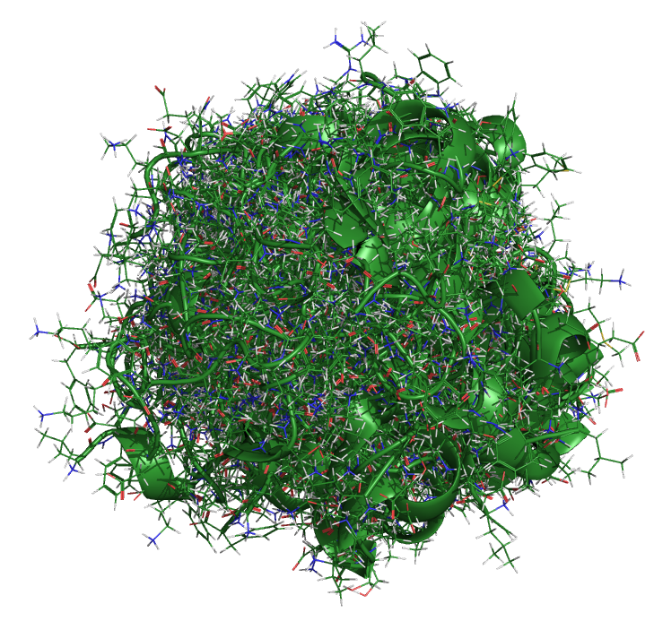
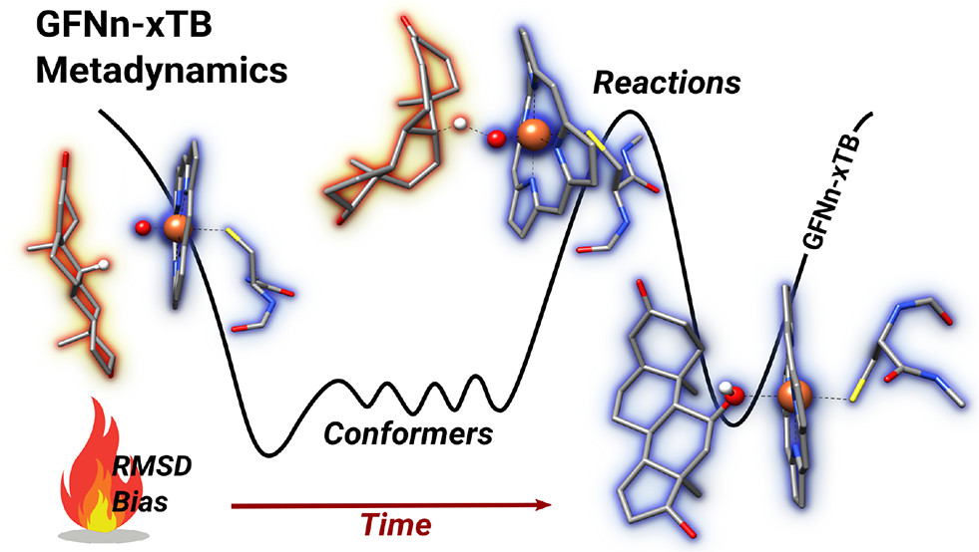

CREST and Conformational Searching
CAML 2024 Jaca, Spain
Heidi Klem – June 17, 2024
National Institute of Standards and Technology
Thermodynamics Research Center
Boulder, Colorado

Slide 2
Core Computational Chemistry Methods
Density Functional
Theory
Molecular Mechanics
Semiempirical
Ab Initio
Classical mechanics
Computationally inexpensive
Parameterized force fields
Based on Schrödinger equation
Parameterized with empirical data
Based on Schrödinger equation
Electron density rather than wavefunction
Quantum mechanics
Schrödinger equation
Approximations required
1998 Nobel Prize in Chemistry
John Pople “for his development of computational methods in quantum chemistry”
Walter Kohn “for his development of the density functional theory”
2013 Nobel Prize in Chemistry
Martin Karplus, Michael Levitt, and Arieh Warshel “for the development of multiscale models for complex chemical systems”

Slide 3
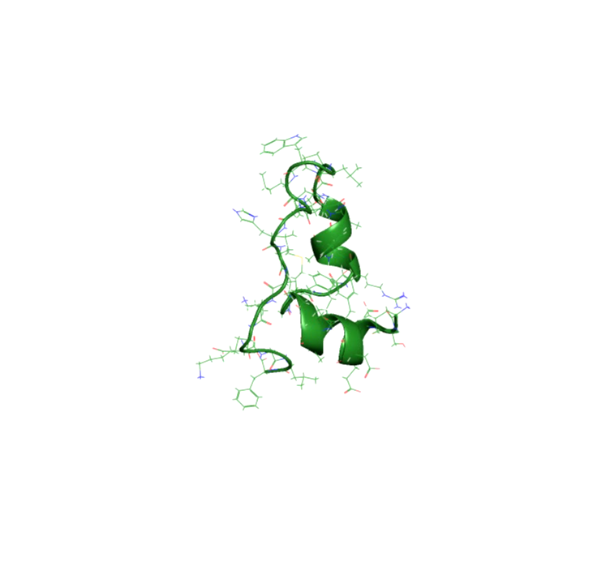
“Everything that living things do can be understood
in terms of the jiggling and wiggling of atoms”
- Richard Feynman
Snapshots from a 105 µs trajectory
Chicken villin heapiece-35 (HP35)
Simulation by D.E.Shaw Research
Notes:
Atoms are in perpetual motion (because absolute 0 in Kelvin is theoretical).

Slide 4
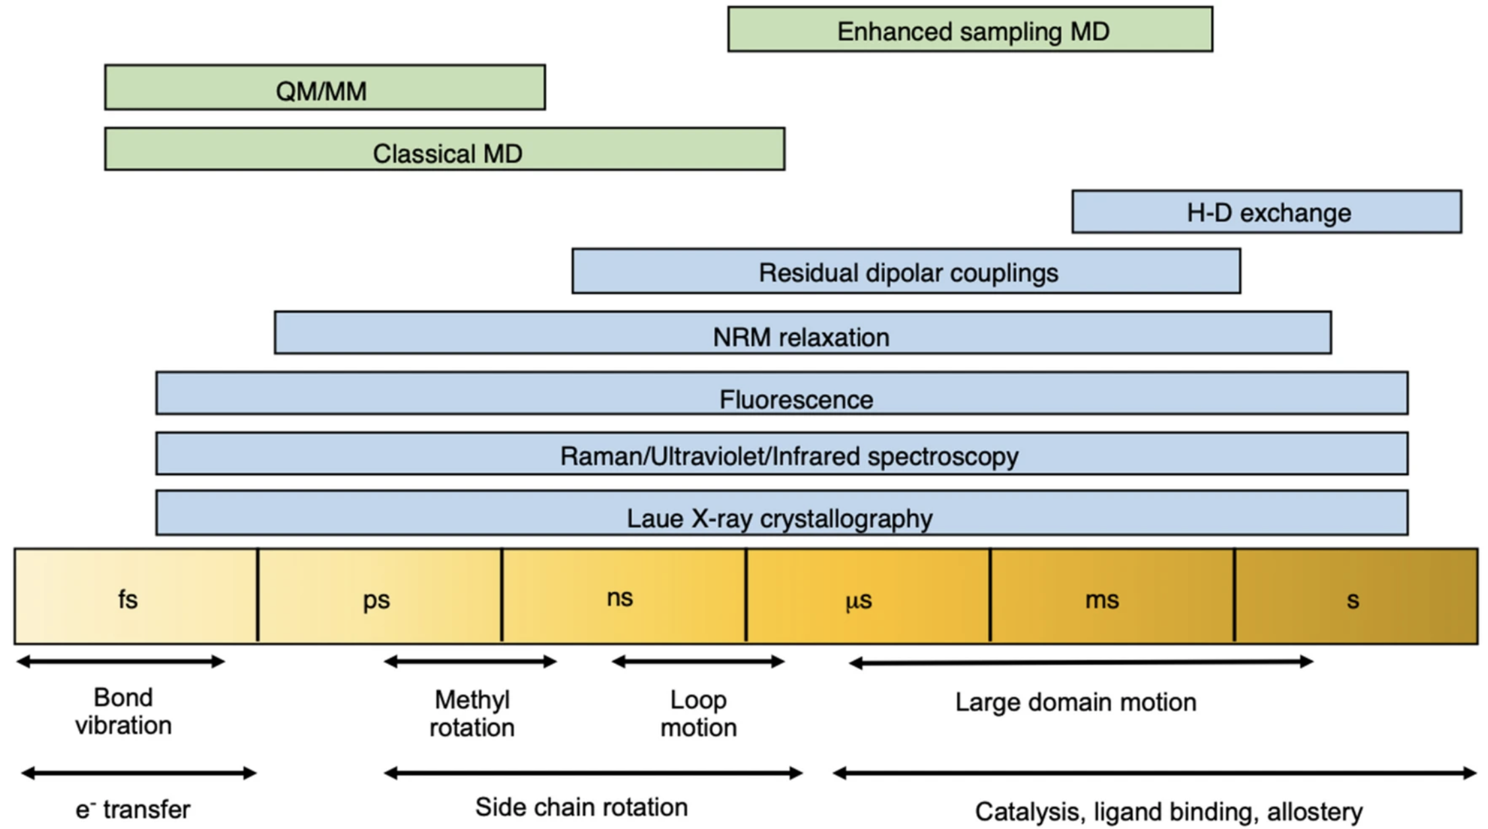
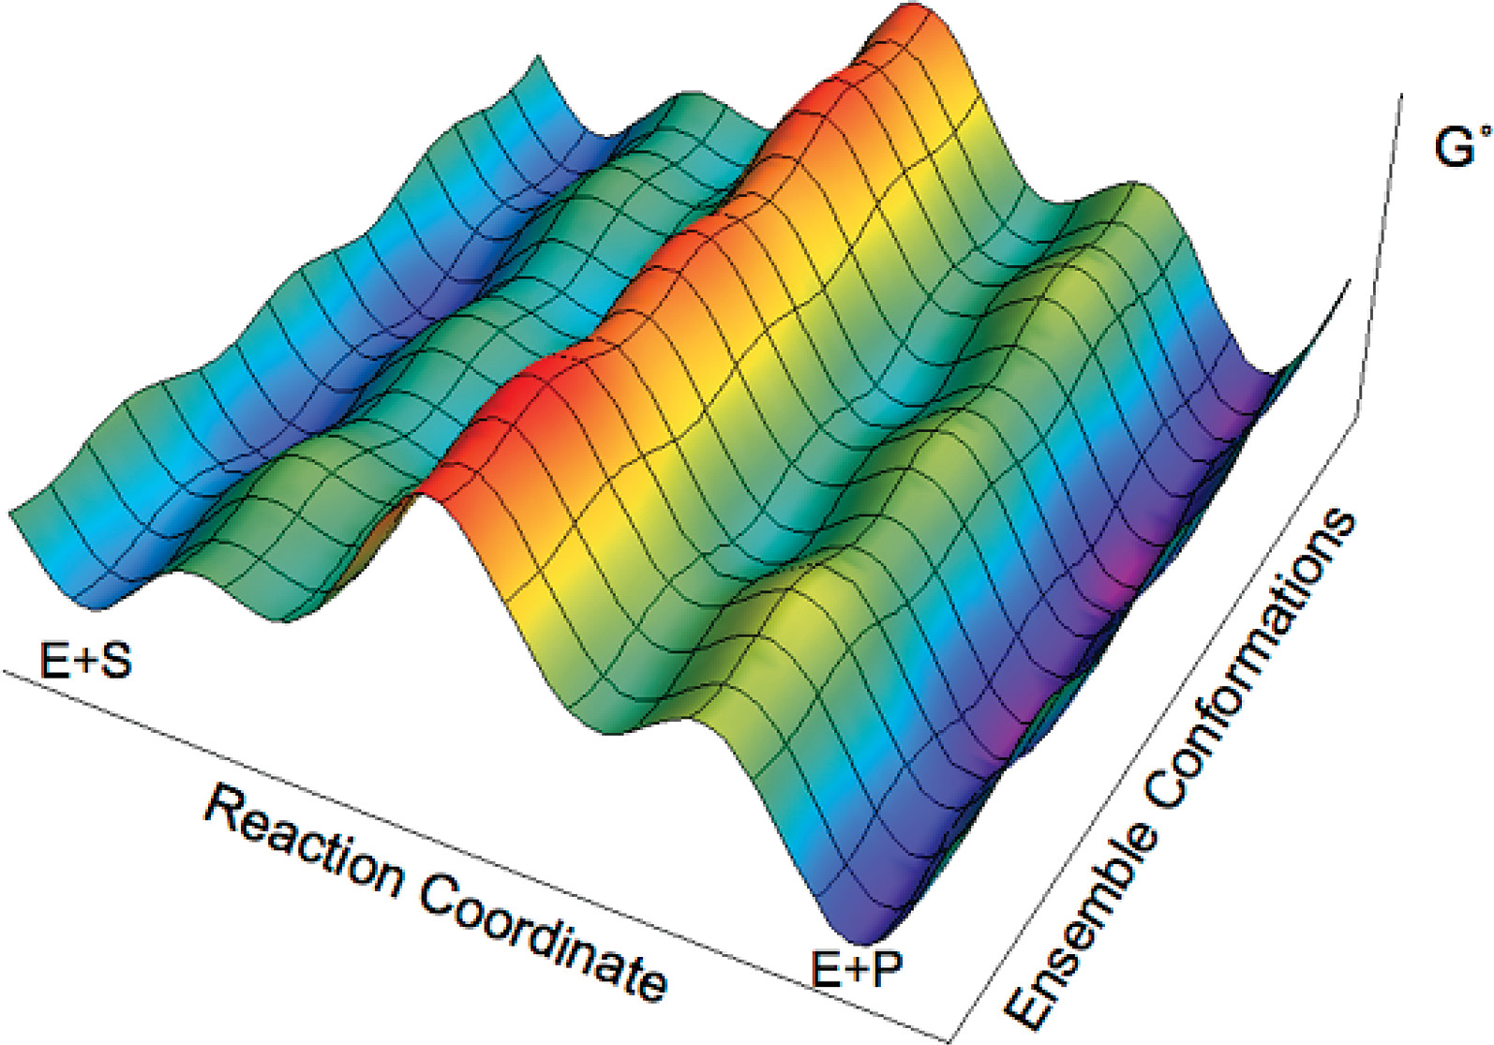
Molecular Motions
Multiple populations of conformations, intermediates, and transition states can exist.
Consider macroscopic/bulk
vs. microscopic
Notes:
Potential energy surface: describes the relationship between molecular geometry and energy
Conformational analysis is one of the central topics in computational chemistry.

Slide 5

How can we model chemistry consistent with experiment?

Slide 6
Clarifying terminology
Geometry versus Conformer
Stochastic
versus
Systematic
Notes:
stochastic: random variable or process

Slide 7
Stochastic approach
Molecular dynamics (time evolution of atomic positions) to explore conformational landscape
Goal is to sufficiently sample phase space to directly obtain the Boltzmann weighted conformational ensemble
Represent geometric distributions that represent the experimentally relevant conformational ensemble
Applications to large molecules (well beyond 500 atoms)

Slide 8
Example: protein folding
Structural clustering can be used to identify and quantify stable conformations
The resulting discretized trajectory data can be used with Markov State Modeling to recover the equilibrium properties of a process.

Slide 9
How can we model chemistry consistent with experiment? How can we do this accurately and efficiently?

Slide 10
Systematic approach
Goal is to identify lowest energy conformers that represent the experimentally relevant conformational ensemble with automated heuristics
Better suited for small molecules ( < 100 atoms) often involving iterative procedures
Calculations performed on minimized conformers and results are Boltzmann averaged
Depending on the size of the molecule, it might be possible to figure out all possible conformers
Notes:
Heuristic:
Of or relating to a usually speculative formulation serving as a guide in the investigation or solution of a problem.
Of or constituting an educational method in which learning takes place through discoveries that result from investigations made by the student.
Relating to or using a problem-solving technique in which the most appropriate solution of several found by alternative methods is selected at successive stages of a program for use in the next step of the program.

Slide 11
Conformational analysis
Can be computationally demanding depending on the accuracy you seek
Intelligently designed workflows, often involving multiple optimization rounds, can reduce the computational demand
Automation can promote reproducibility and reduce headaches!
A VERY general workflow might look like:
1. Efficiently and broadly generate geometries (stochastic and or systematic)
2. Fast geometry optimization and rank resulting conformers
3. Remove duplicates, select subset and reoptimize to refine ranking

Slide 12
Gets-the-job-done optimization
ANI-1
Accurate NeurAl network engine for Molecular Energies
Deep neural network train on QM DFT calcs
Applies only to HCNO atoms
GAFF
General AMBER force-field
Parameterized for small organic molecules
GFN-FF
Generic polarizable force-field of the GFN family of methods
All elements up to Radon
GFN2-xTB
Geometries, Vibrational Frequencies, and Noncovalent interactions
eXtensions in the AO basis set using density functional Tight Binding methods (tight-binding DFT)
All elements up to Radon
GP3?!
Smith, J. S., Isayev, O. & Roitberg, A. E. ANI-1: an extensible neural network potential with DFT accuracy at force field computational cost. Chem. Sci. 8, 3192–3203 (2017).
Sprenger, K. G., Jaeger, V. W. & Pfaendtner, J. The General AMBER Force Field (GAFF) Can Accurately Predict Thermodynamic and Transport Properties of Many Ionic Liquids. J. Phys. Chem. B 119, 5882–5895 (2015).
Spicher, S. & Grimme, S. Robust Atomistic Modeling of Materials, Organometallic, and Biochemical Systems. Angew Chem Int Ed 59, 15665–15673 (2020).
Bannwarth, C., Ehlert, S. & Grimme, S. GFN2-xTB—An Accurate and Broadly Parametrized Self-Consistent Tight-Binding Quantum Chemical Method with Multipole Electrostatics and Density-Dependent Dispersion Contributions. J. Chem. Theory Comput. 15, 1652–1671 (2019).

Slide 13
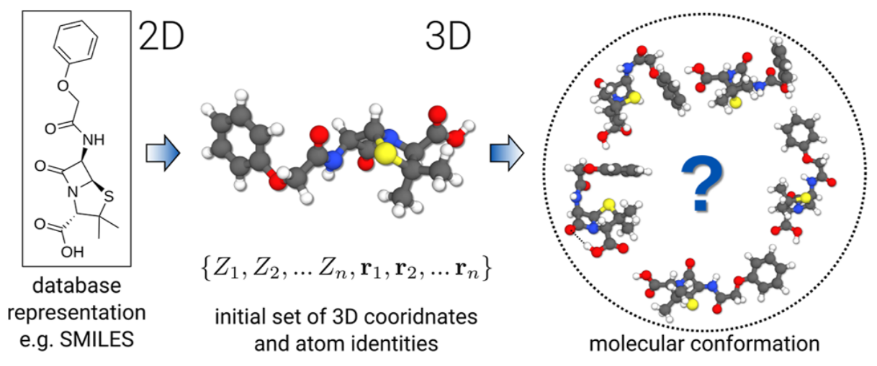
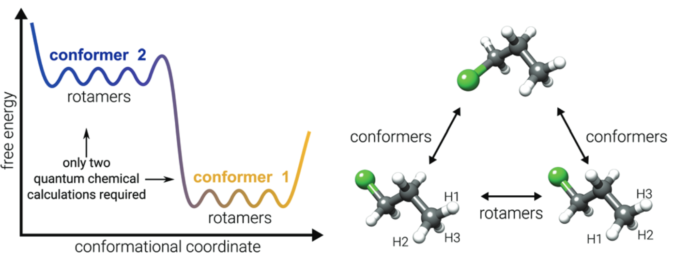
CREST
Conformer-Rotamer Ensemble Sampling Tool
For energy calculations and geometry optimizations, CREST uses either force field or semiempirical methods.

Slide 14
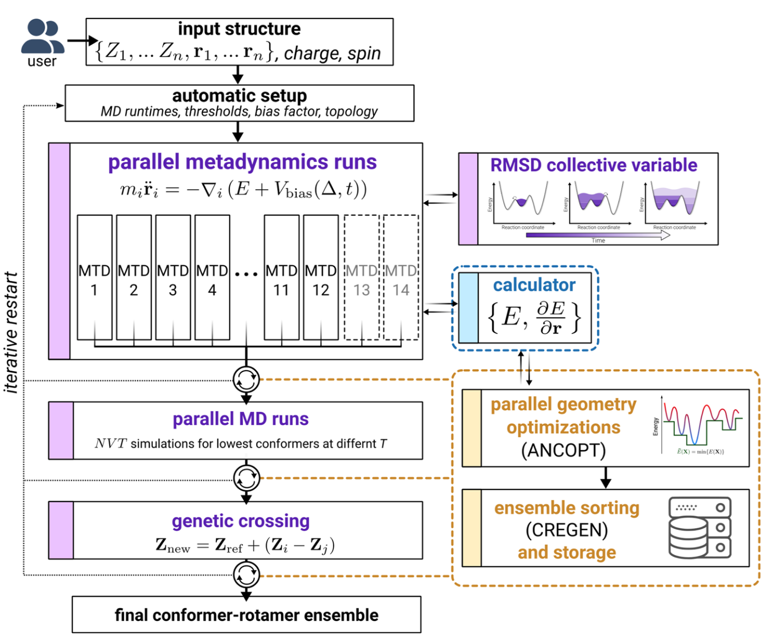
CREST iMTD-GC workflow
But first- let’s open up a Jupyter Notebook and get a calculation running, then we will talk about the procedure as it runs.
Parallel runs to vary parameters in the bias potential
MTDs are well-suited to cross high-barriers, at the cost of missing some small-barrier changes
MD runs are performed at two different temperatures on usually the lowest 4 confs found so far, to target rotamer sampling
Rotamer sampling is augmented by use of a GC algorithm to introduce “mutations”
The confs generated at each stage are reoptimized using the Approximate Normal Coordinate OPTimizer (ANCOPT) algorithm and if at any point a new lowest energy conf is found the process is restarted.

Slide 15
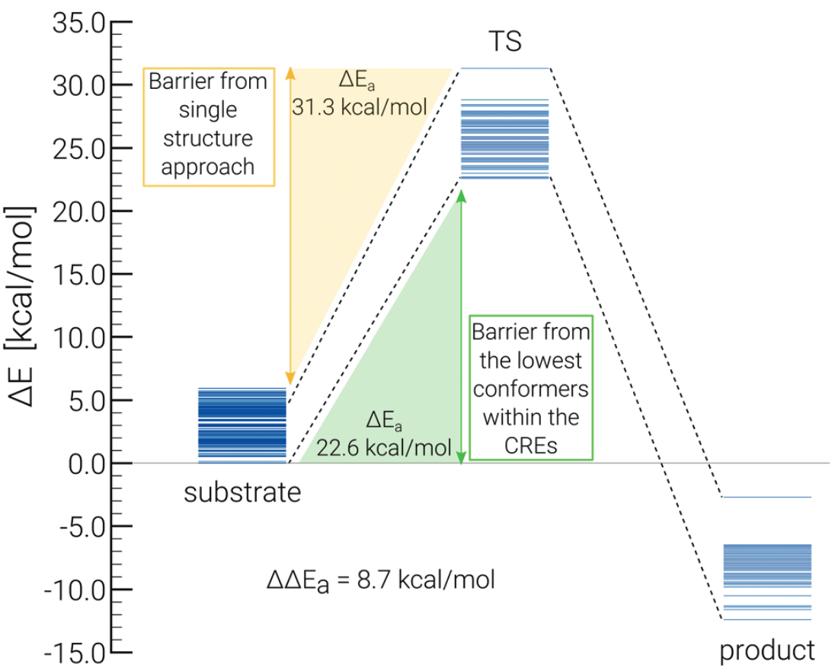
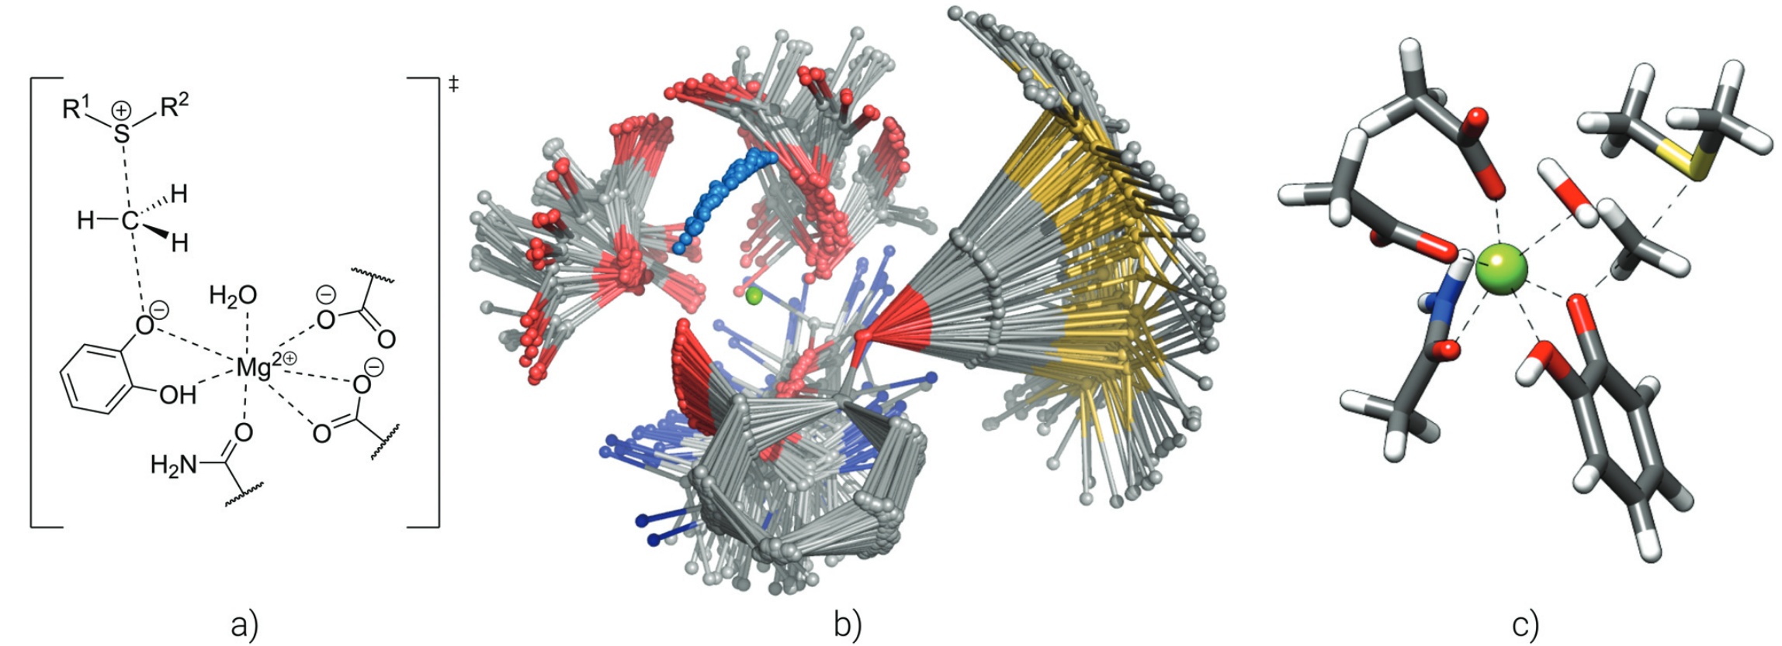
Constraints and non-covalent complexes
An ellipsoidal potential can be used to encapsulate the studied complex and avoid problems due to the metadynamics bias in non-covalent complexes
As opposed to previous program versions, CREST 3 implements the complete freezing of atoms in all metadynamics simulations and geometry optimizations
Pracht, P., Bohle, F. & Grimme, S. Automated exploration of the low-energy chemical space with fast quantum chemical methods. Physical Chemistry Chemical Physics 22, 7169–7192 (2020).

Slide 16
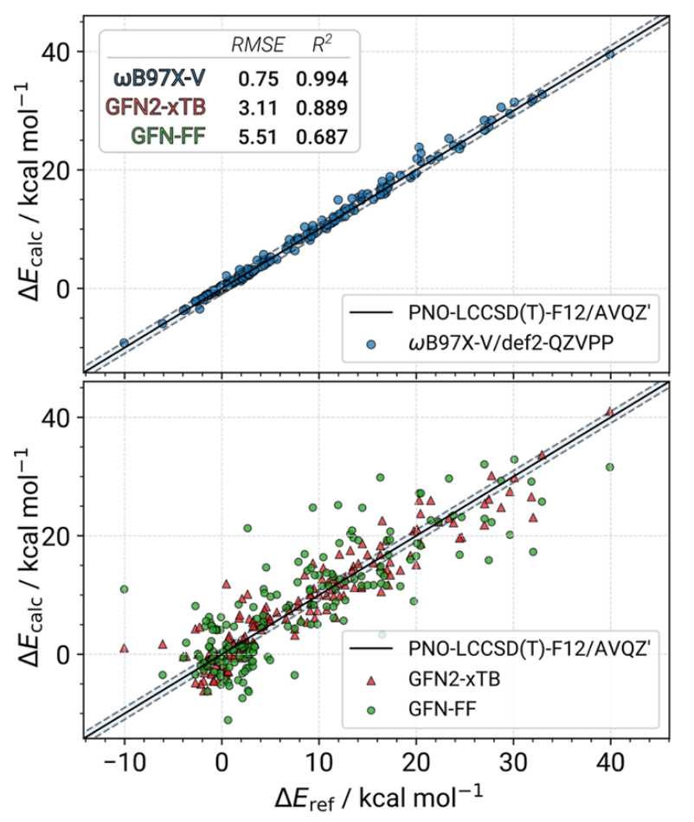
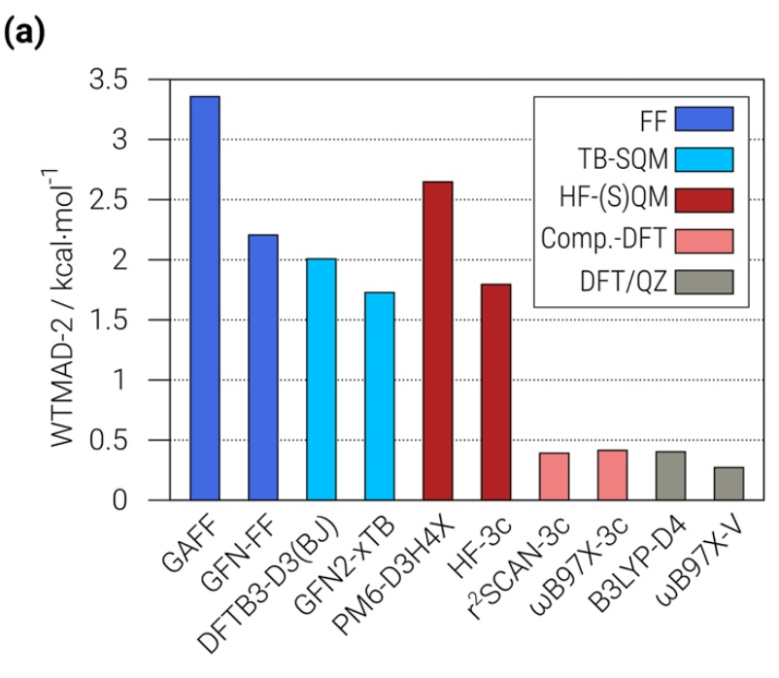
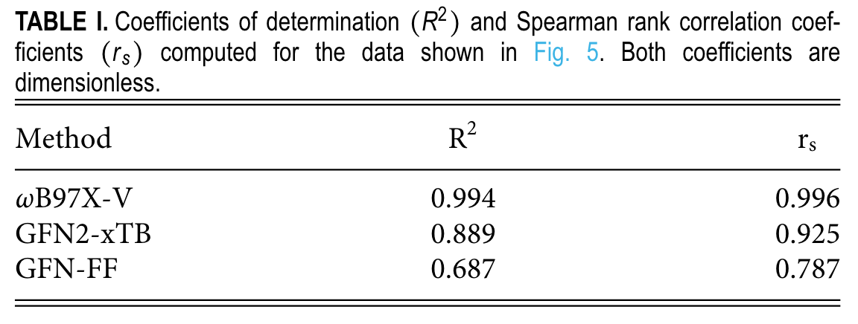
CREST benchmarking
GFN2-xTB
Conformational energies are more accurate than HF-S(QM), and less accurate than composite DFT methods
Much faster, and perform well in correctly ordering the conformers
Pracht, P. et al. CREST—A program for the exploration of low-energy molecular chemical space. The Journal of Chemical Physics 160, 114110 (2024).

Slide 17
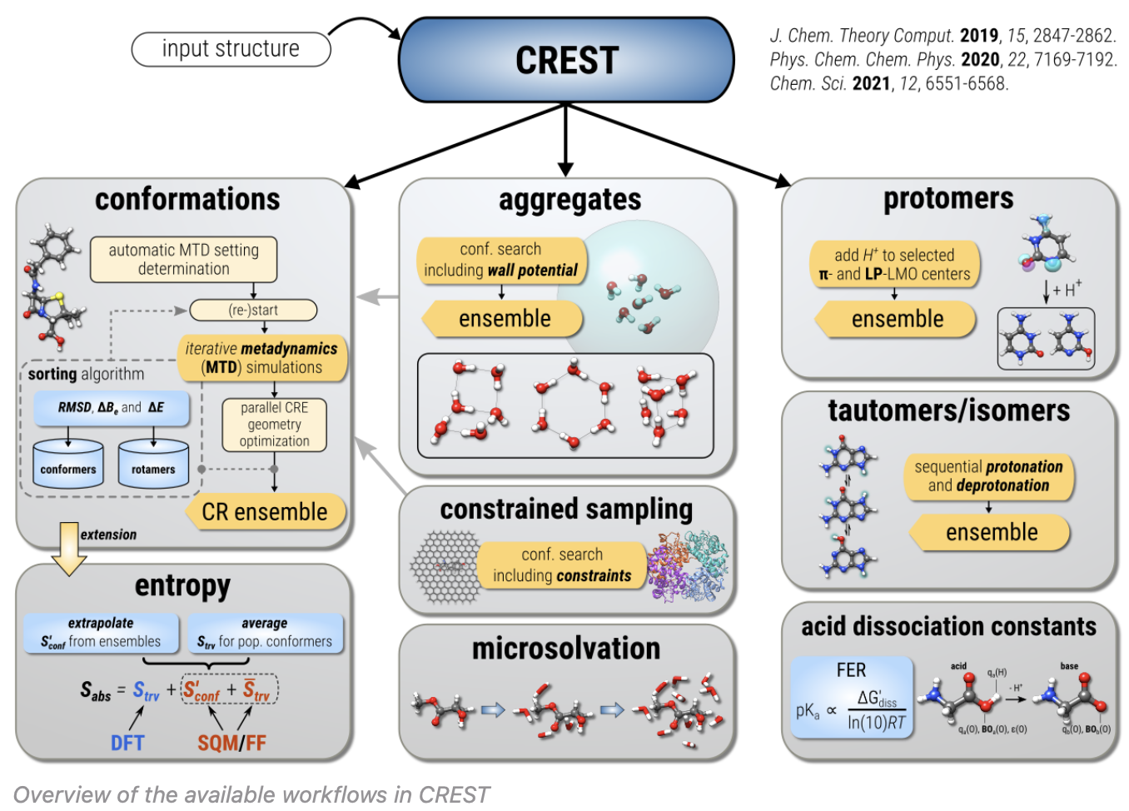
CREST ecosystem

Slide 18
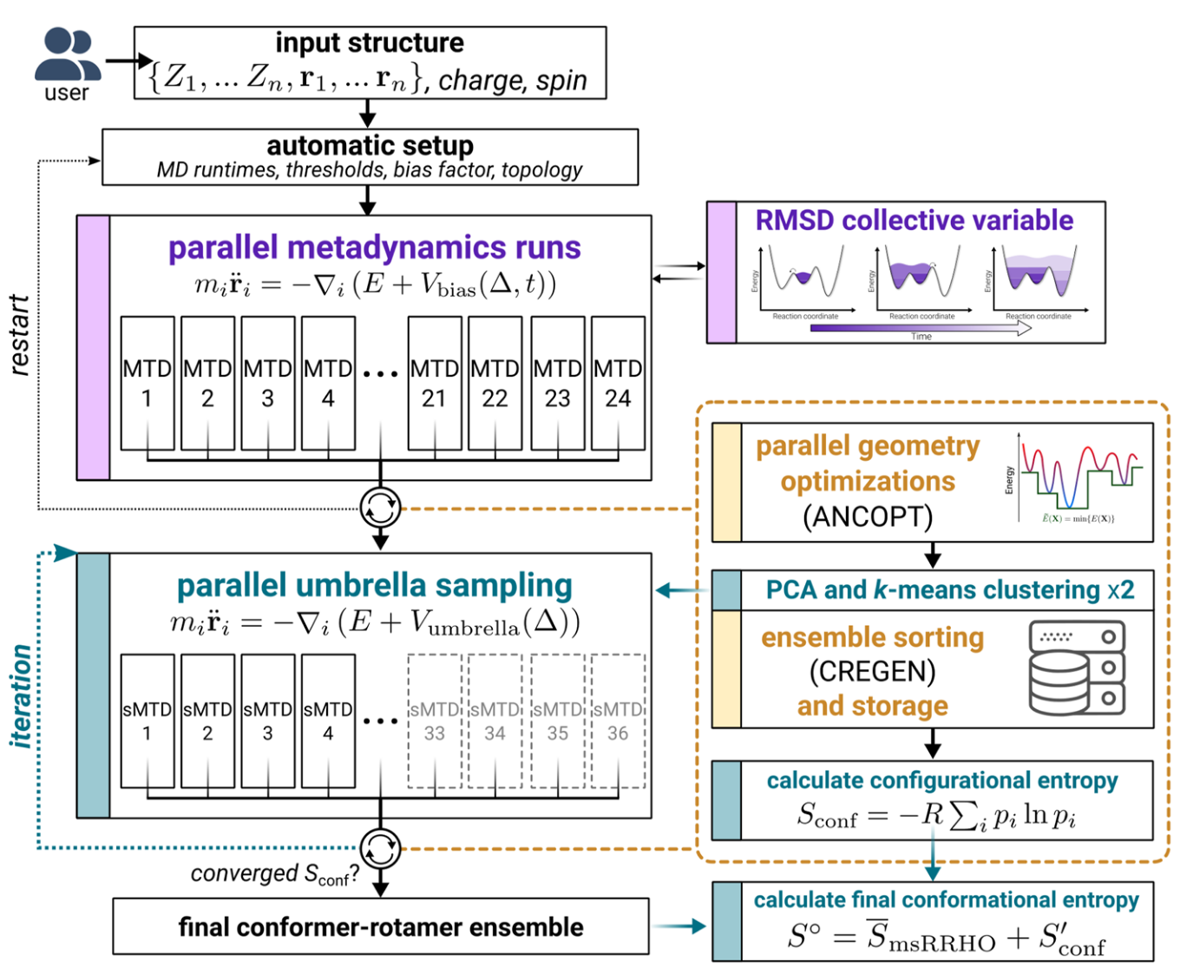
New and improved features in CREST 3.0
Iterative metadynamics–static metadynamics (iMTD-sMTD) workflow used to calculate the configurational entropy.
TOML based configuration files instead of just command line (significantly improves interoperability).
Stand alone single-point energy/gradient evaluation and geometry optimization available with --sp or --opt flag
QM/MM support
Can someone please write an entropy related script called entro.py?

Slide 19
Discussion points
Is the lowest energy conformer sufficient? How can you support that? Experimental data is our friend, but remember what assumptions go into out modeling.
What assumptions are being made? If you are truncating the system for ease of calculation, is the resulting conformational space adequately similar? Constraints!
There is no one-size-fits-all solution, unfortunately. (show web-plot from 2024 CREST paper comparing different approaches in different benchmarking sets.
Similar to transition state (TS) searches, conformational searches are an art.
CREST is broadly applicable: very approachable for new students, highly adaptable for more complex situations, interoperable/modular, open-source and going-strong, but it is not the complete solution!
Starting structure bias
Anyone have a fun/ugly/cool/ conformational analysis related research story to share?

